Slide 1
Institutional Preference Survey
Prepared for State University of New York College at Old Westbury
March 2022

Slide 2
Overview
Key Objectives
Identify factors that contribute to students’ enrollment decisions.
Determine which competitors non-matriculants have ultimately chosen and what guided these enrollment choices.
Evaluate the impact of COVID-19 on students’ higher education plans for the Fall 2021 term.
Survey Sample
213 responses

Slide 3
Survey Sample

Slide 4
Respondent Characteristics
Gender (n=203)
Female | 80%
Male | 18%
Non-binary/Gender non-conforming | 1%
Not listed/Prefer to self-describe | 0%
Prefer not to respond | 0%
Employment (n=203)
Employed part-time while attending school | 47%
Not employed | 34%
Employed full-time | 14%
Prefer not to respond | 2%
Employed part-time and not attending school | <1%
Other | 2%
Race/Ethnicity (n=203)
American Indian or Alaska Native | 1%
Asian | 18%
Black or African American | 23%
Hispanic/Latino | 33%
Middle Eastern or North African | 1%
Native Hawaiian or Other Pacific Islander | 0%
White | 29%
Not listed/Prefer to self-describe | 2%
Prefer not to respond | 3%
Did your parent(s) graduate from college? (n=203)
No | 48%
Yes, one parent | 25%
Yes, both | 20%
Prefer not to respond | 4%
Don't know | 3%
Household Income (n=203)
Under $25,000 | 17%
$25,000 to $49,999 | 26%
$50,000 to $74,999 | 12%
$75,000 to $99,999 | 5%
$100,000 to $149,999 | 9%
$150,000 to $199,999 | 2%
$200,000 or more | 1%
Prefer not to respond | 26%
Notes:
If you need an icon for a demographic characteristic not listed here, you may either use PowerPoint’s built-in icon library, or the icon library available on the Hub, in the Brand Portal.

Slide 5



HANOVER Recommendations
Improve financial aid communications to ensure that students are aware of their expected out-of-pocket cost.
Improve marketing messaging and differentiation among OW’s academic offerings to better convey SUNY OW’s academic fit.
Highlight SUNY OW’s affordability, value for the cost, and overall quality in marketing collateral.
Longer term
Optimize financial aid awards – institutional aid very limited at this time. Fundraising required.

Slide 6
Application decision Factors
Our matriculants place the greatest importance on proximity to home.
Non-matriculants value financial aid packages more highly.
Note: The chart includes the five most-selected items by each group. An asterisk (*) indicates a statistically significant difference between groups. † indicates that item text has been truncated for chart legibility.

Slide 7
Enrollment decision factors
Nearly 2/3 of matriculants: affordability (65%) and closeness to family/home (63%).
Most non-matriculants: good fit for what they want to study (66%).
Why did you decide to enroll at [SUNY OW/your current university]? Please select all that apply. | Matriculant (n=144) | Non-Matriculant (n=50)
Affordability | 65% | 50%
Close to my family/home | 63% | 56%
Good fit for what I want to study | 54% | 66%
Provides good value for the money | 41% | 34%
Flexible transfer credit policies | 38% | 28%
Offered a good financial aid package†* | 34% | 54%
Close to where I want to live | 30% | 30%
Positive experience with the application process | 29% | 34%
Availability or diversity of extracurricular activities | 17% | 24%
A friend or relative was attending | 17% | 22%
Campus social life | 9% | 18%
Highest-ranked school to which I was accepted* | 5% | 14%
Offered a spot on an athletics team | 2% | 2%
Note: An asterisk (*) indicates a statistically significant difference between groups. † indicates that item text has been truncated for chart legibility. The question to the left was only displayed to non-matriculants who reported receiving a financial aid offer from SUNY OW.

Slide 8
Transfer Students’ Decisions
Transfer students - heavily influenced by alignment with their academic interests and transfer credit policies.
Transfer applicants who applied to multiple schools are more likely than first-year applicants to rank SUNY OW as their first-choice.

Slide 9
Decisions not to Enroll at SUNY OW
Decisions not to enroll at SUNY OW are motivated largely by
program fit (34%)
its proximity to family/home (25%)
and the financial aid package it offered (25%)

Slide 10
Financial Considerations
Roughly 1/3 of respondents reported not knowing their expected out-of-pocket cost to attend SUNY OW.
Roughly 3/4 of non-matriculants’ decision not to enroll pertained to SUNY OW’s annual tuition price and financial aid award.
Note: Both charts include responses from non-matriculants only.

Slide 11
Enrollment Among Competitors
More non-matriculants applied to Stony Brook University (50%) than to any other listed institution, but less than 1/10 chose Stony Brook.
67% of non-matriculants chose institutions outside of SUNY OW’s selected competitor group including Malloy and Howard University.
Note: An asterisk (*) indicates a statistically significant difference between groups. The question to the right was displayed to non-matriculants who enrolled elsewhere. ± indicates items were displayed to participants who previously reported applying to those institutions.

Slide 12
COVID-19 Impact
Non-matriculants are significantly more likely to report COVID-related impacts to their college plans.
50% of surveyed non-matriculants indicate that COVID-19 impacted their higher education plans for the Fall 2021 term, compared to roughly 1/4 of matriculants (28%).
SUNY OW’s vaccine requirement had little impact on students’ enrollment decisions.
For most applicants, SUNY OW’s vaccine requirement had no impact on the likelihood of enrollment (56%), and it increased the likelihood of enrollment for just over one-quarter of participants (27%).
Note: An asterisk (*) indicates a statistically significant difference between groups.

Slide 13
Changes as a result of COVID-19
Non-matriculants are nearly twice as likely as matriculants to have enrolled at a less expensive college or university in response to the pandemic (52% compared to 28%).
Note: An asterisk (*) indicates a statistically significant difference between groups. † indicates that item text has been truncated for chart legibility. The chart to the right includes the two most-selected items.

Slide 14
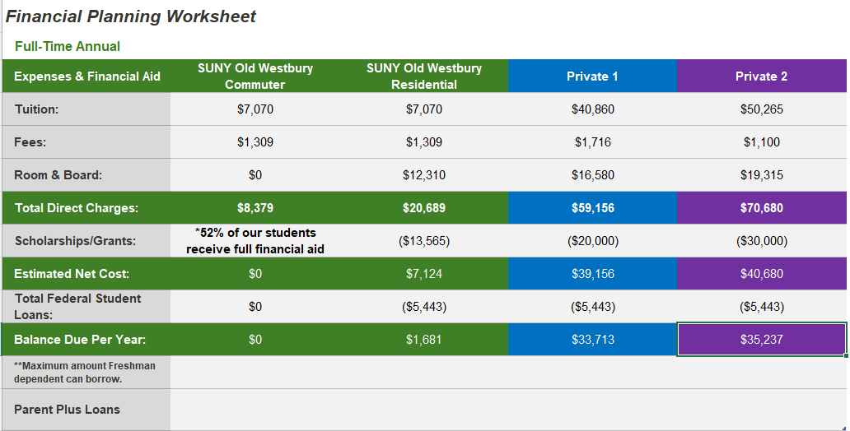
One Innovation to Address Affordability

Slide 15
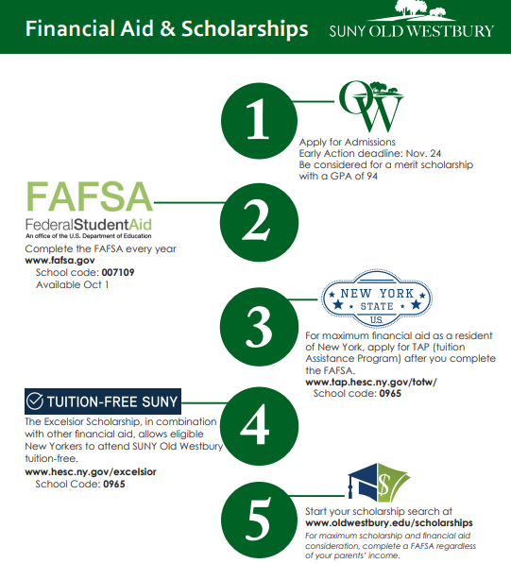
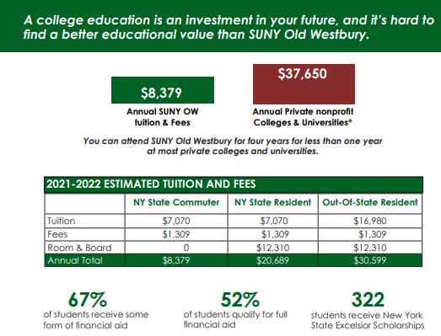
Produced Financial Aid sheet Oct. 2021

Slide 16
Demand is Strong
Five-year, year over year comparison of deposits levels as of 5/3
Deposits | First Year | Difference | Transfer | Difference | Sp. Category | Total deposits
Fall 2022 | 580 | 90% increase | 147 | 20% increase | 61 | 788
Fall 2021 | 305 | 1% decrease | 123 | n/a
Fall 2020 | 308 | 74% decrease | n/a | n/a
Fall 2019 | 536 | 24% decrease | 205 | 12% decrease
Fall 2018 | 703 | highest FY ever | 233 | n/a
as of 5/3/22
Admissions hosted more than 1,069 guests in April 2022:
13 group tours, many from NYC schools
6 weekend tours including 4/9/22
3 NYC events at SUNY Global

